Slide 1
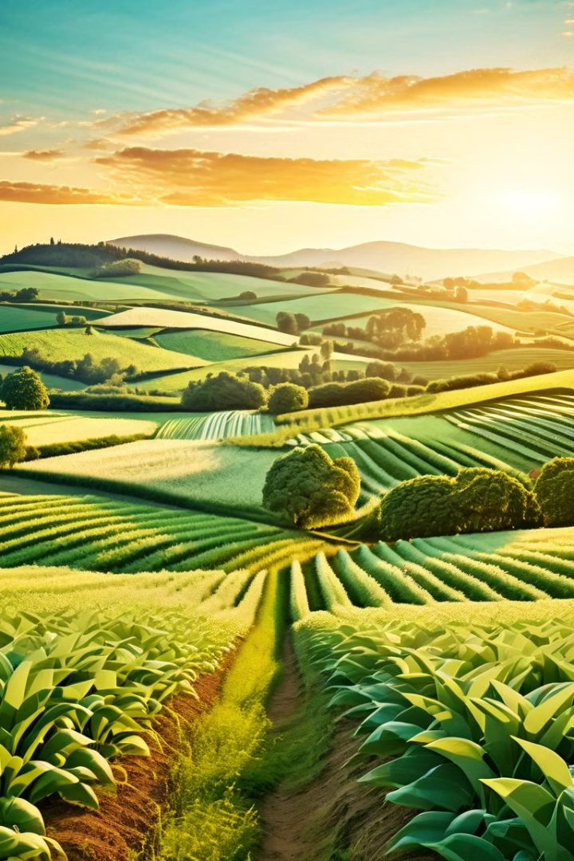
Intelligent Solutions
for Crops using Crop Recommendation, Fertilizer Suggestion, and Plant Disease Detection
Project Members: 1. A.Santhosh Kumar –Y20ACS403 2. G.Harshitha -Y20AC445 3. B.Bhavana Sai –Y20ACS419 4. B.Ajay Kumar –Y20ACS414
Project Guide: Mr T.Y.Srinivasa Rao

Slide 2
Abstract
Precision agriculture is advancing rapidly, integrating machine learning and deep learning techniques to create a comprehensive system for crop recommendation, fertilizer suggestion, and plant disease detection. This system aims to optimize crop selection, recommend suitable fertilizers, and identify potential crop diseases by leveraging data on crop attributes, soil characteristics, and environmental factors such as soil type, climate, rainfall, humidity, and temperature, as well as parameters like nitrogen, phosphorus, and potassium content in the soil. The ultimate goal is to enhance agricultural productivity and minimize crop losses through tailored solutions.

Slide 3
Existing System
Plantix
Plantix is a mobile application that offers plant disease detection and pest recognition services. It uses image recognition technology.
AgroCares Scanner
AgroCares Scanner is a handheld device that measures nutrient levels in soil samples and provides instant analysis through a mobile application.
Green IQ
An AI-powered platform that offers personalized recommendations for plant care, including watering schedules, fertilizer application, and pest management strategies.

Slide 4
Proposed System
Our proposed system uses computer techniques to assist farmers in managing their crops better. It provides guidance on which crops to grow, which fertilizers to use, and how to identify plant diseases. This platform helps farmers make smarter decisions and enhance their farming methods. By analyzing large amounts of data, it can offer accurate suggestions for crop management, fertilizer suggestion, and disease detection.

Slide 5
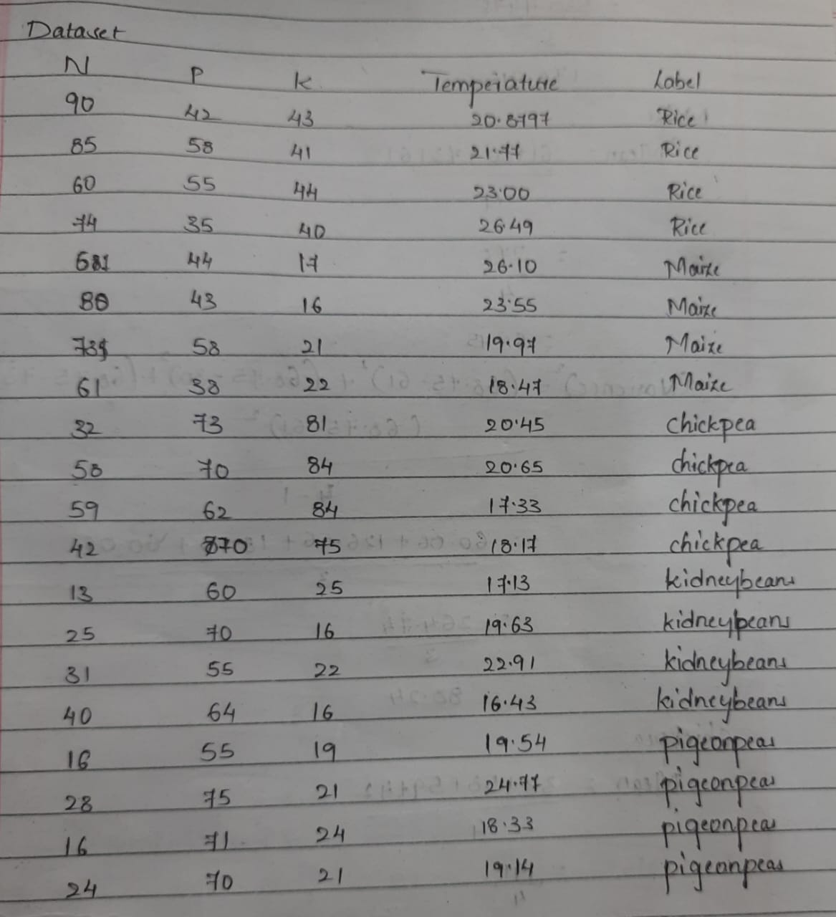
Dataset
Among the 2200 samples we considered these 20 samples for analysis

Slide 6
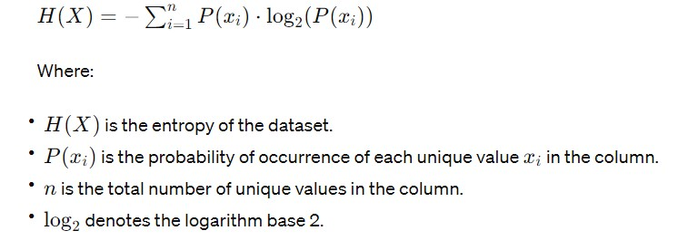
Formula for Entropy

Slide 7
Contd..
Entropy of the N:
We are considering the bins:
bin1 - 10 to 19 - 3
bin2 - 20 to 29 - 3
bin3 - 30 to 39 - 2
bin4 - 40 to 49 - 2
bin5 - 50 to 59 - 2
bin6 - 60 to 69 - 3
bin7 - 70 to 79 - 2
bin8 - 80 to 89 - 2
bin9 - 90 to 99 - 1
Entropy(label) = 2.3219
Entropy(N) = 3.1076
Entropy(P) = 2.0643
Entropy(K) = 2.1219
Entropy(Temperature) = 1

Slide 8
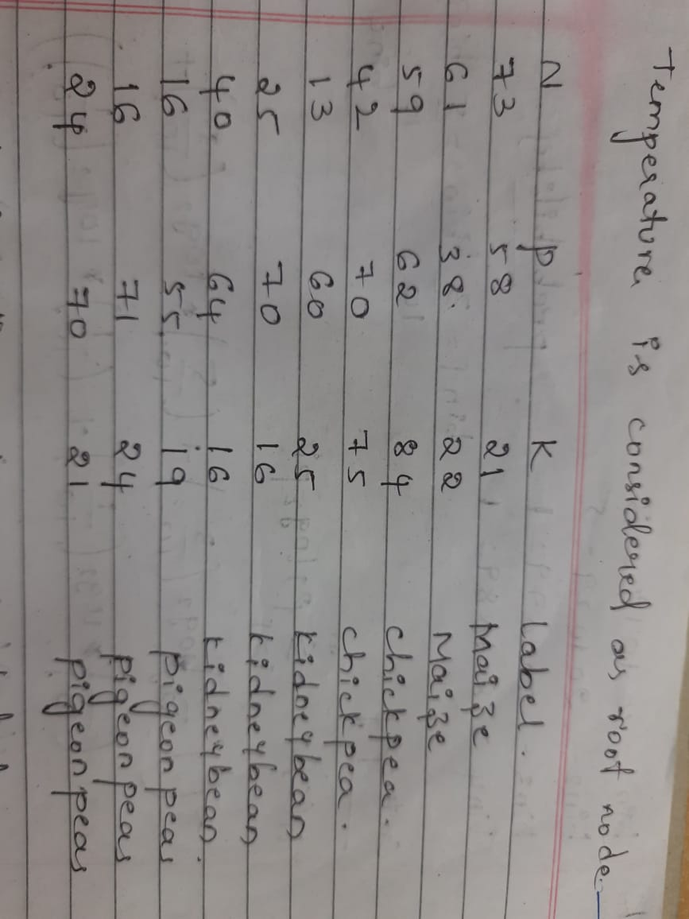
Contd..
Information gain:
Information gain(N) = Entropy(label) - Entropy(N) = 2.3219-3.1076 = -0.7857
Information gain(P) = Entropy(label) - Entropy(P) = 2.3219-2.0643 = 0.2573
Information gain(k) = Entropy(label) - Entropy(K) = 2.3219-2.219 = 0.19917
Information gain(Temperature) = Entropy(label) - Entropy(Temperature) = 2.3219-1 = 1.3219
Here Temperature is considered as root node

Slide 9
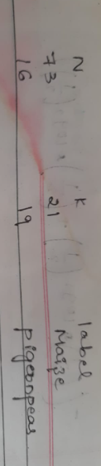
Contd..
Entropy(N) = 2.114
Entropy(P) = 1.588
Entropy(K) = 1.6854
Information Gain:
Information gain(N) = Entropy(label) - Entropy(N) = 1.9709 - 2.114 = -0.1432
Information gain(P) = Entropy(label) - Entropy(P) = 1.9709 - 1.588 = 0.3822
Information gain(K) = Entropy(label) - Entropy(k) = 1.9709 - 1.6854 = 0.2885
We consider the P as root node
Entropy(label) = 1
Entropy(N) = 1
Entropy(K) = 1
We consider the N as root node

Slide 10
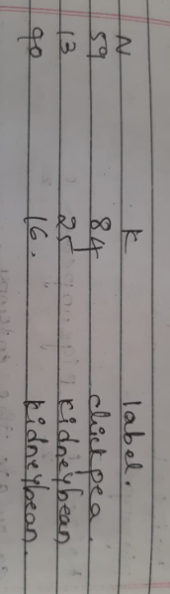
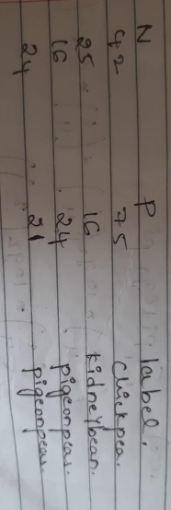
Contd..
Entropy(label) = 0.826
Entropy(N) = 1.426
Entropy(K) = 1.426
We consider the k as root node
Entropy(label) = 1.5
Entropy(N) = 1.5
Entropy(K) = 1.5
We consider the potassium as root node

Slide 11
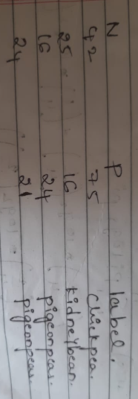
Contd..
Entropy(label) = 1.5
Entropy(N) = 1.5
Entropy(P) = 1.5
We consider the p as node
10 to 19 --> kidney bean
20 to 29 --> pigeon peas
70 to 79 -- >chickpeas

Slide 12
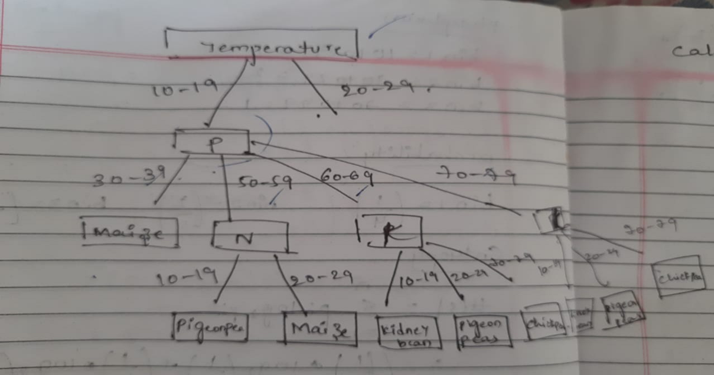
Contd..

Slide 13
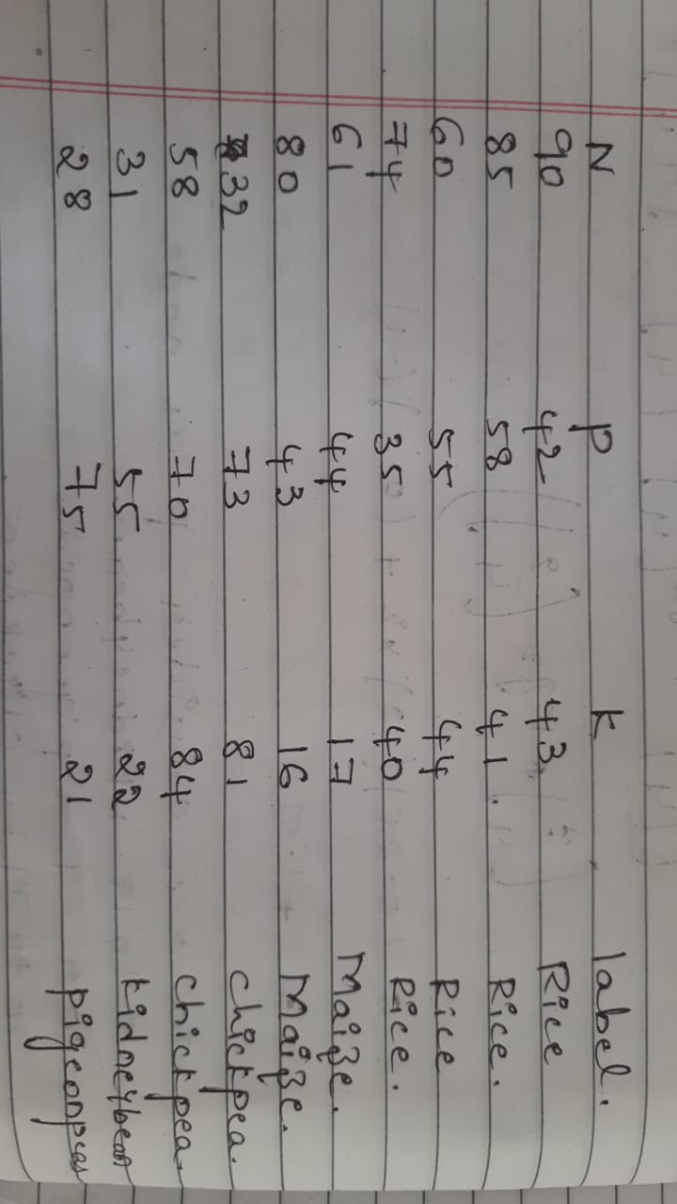
Contd..

Slide 14
Contd..
Entropy(label) = 1.7
Entropy(N) = 3
Entropy(P) = 1.5924
Information gain(N) = Entropy(label) - Entropy(nitrogen) = 1.7 - 3 = -1.3
Information gain(P) = Entropy(label) - Entropy(phosphors) = 1.7 - 1.5924 = 0.1076
Information gain(K) = Entropy(label) - Entropy(potassium) = 1.7 – 3 = -1.3
We consider the phosphors as root node
Entropy(label) = 0.962
Entropy(N) = 1.56
Entropy(P) = 0.962
We consider the nitrogen as root node
Information gain(N) = Entropy(label) - Entropy(nitrogen) = 0.962 - 1.56 = -0.598
Information gain(P) = Entropy(label) - Entropy(phosphors) = 0.962 - 0.962 = 0
We consider the potassium as node
Entropy(N) = 1.56
Entropy(P) = 0.962
Information gain(N) = Entropy(label) - Entropy(nitrogen) = 0.962 - 1.56 = -0.598
Information gain(K) = Entropy(label) - Entropy(potassium) = 0.962 - 0.962 = 0
We consider potassium as node

Slide 15
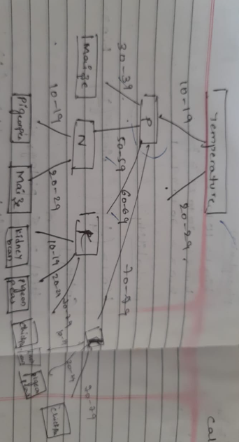
Contd..
Entropy(label) = 0.962
Entropy(N) = 1.56
Entropy(P) = 0.962
Information gain(N) = Entropy(label) - Entropy(nitrogen) = 0.962 - 1.56 = -0.598
Information gain(k) = Entropy(label) - Entropy(potassium) = 0.962 - 0.962 = 0
Potassium is considered as the node
20 to 29 -> pigeon peas
80 to 89 -> chickpeas

Slide 16
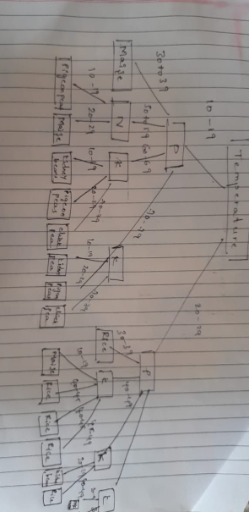
Contd..

Slide 17
Time Complexities(According to labels)
Time Complexity | Decision Tree | Random Forest
5 Labels | O(NP^2) | O(T×NPlogN) to O(TxNP^2)
10 Labels | O(NP^2) | O(T×NPlogN) to O(T×NP^2)
15 Labels | O(NP^2) | O(T×NPlogN) to O(T×NP^2)
20 Labels | O(NPlogN)to O(NP^2) | O(T×NPlogN) to O(T×NP^2)
.
.
.
2200 Labels | O(NP^2) | O(NPlogN)to O(NP^2)
T is the tree
N is the no of instances(row)
P is the no of features

Slide 18
Time Complexities(According to records)
Time Complexity | Decision Tree | Random Forest
100 Records | O(N * K * log(N)) to O(N * K^2) | O(T * N * K * log(N)) to O(T * N * K^2)
200 Records | O(N * K * log(N)) | O(T * N * K * log(N))
300 Records | O(N * KlogN) | O(T * N * KlogN)
400 Records | O(N * K * log(N)) | O(T * N * K * log(N))
.
.
.
2200 Records | O(N * K * log(N)) to O(N * K^2) | O(T * N * K * log(N)) to O(T * N * K^2)
T is the tree
N is the no of instances(row)
P is the no of features

Slide 19
The reasons for the decision tree:
Interpretability:
Decision trees provide a transparent and interpretable model, with the small no of instances the decision-tree structure and rules can be visualized.
Efficiency:
Decision trees are computationally efficient and can handle relatively small datasets with ease. With only 22 instances and 7 features in the dataset, building a decision tree is quick and does not require extensive computational resources.
Handling Non-linear Relationships:
Decision trees can effectively capture non-linear relationships between environmental factors and crop types. Decision trees offer a balance of accuracy, interpretability, and computational efficiency, making them a practical choice for predicting crop types based on environmental factors in the given dataset.
The reasons behind the random forest:
Accuracy:
Random Forests are known for their high predictive accuracy.
By aggregating predictions from multiple decision trees trained on different subsets of the data, Random Forests can reduce overfitting and variance, leading to more accurate predictions compared to individual decision trees.

Slide 20
Contd..
Robustness to Noise:
Random Forests are robust to noise and outliers in the data.
By considering multiple trees trained on different subsets of the data, Random Forests can mitigate the impact of noisy or irrelevant features, resulting in more robust predictions.
Feature Importance:
Random Forests provide a measure of feature importance, which can help identify the most influential environmental factors in determining crop types. By analyzing the feature importances across multiple trees, one can gain insights into which factors are most relevant for predicting crop types in the given dataset.
Automatic Feature Selection:
Random Forests perform automatic feature selection by considering different subsets of features at each split in each tree. This can help identify the most informative features for predicting crop types, simplifying the modeling process and potentially improving predictive performance.
Random Forests offer a powerful and flexible modeling approach for predicting crop types based on environmental factors in the given dataset.

Slide 21
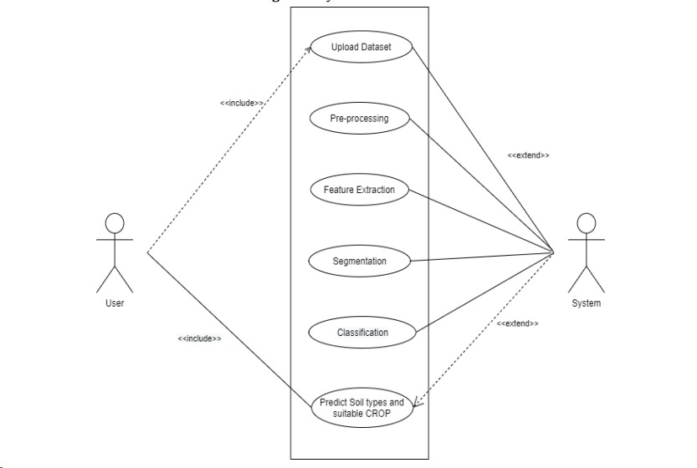
Design
Use Case

Slide 22
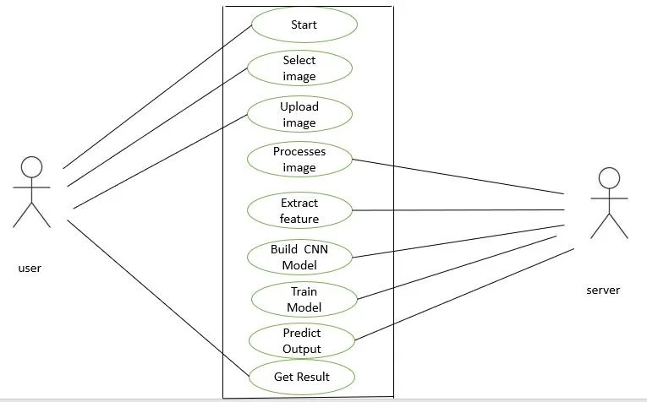
Use Case

Slide 23
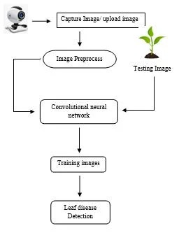
Use Case

Slide 24
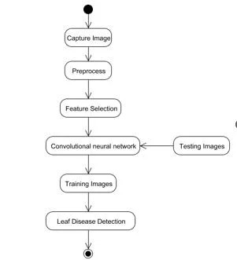
Activity

Slide 25
Convolutional Neural Networks
CNNs are deep neural networks primarily used for analyzing visual imagery, employing a special technique called convolution, which is a mathematical operation on functions. CNNs utilize convolutional layers to extract features by applying small filters across input images. CNNs are trained with large datasets using backpropagation, where the network adjusts its parameters to minimize prediction errors, improving its ability to analyze and interpret visual information.
Residual Networks
Residual Networks (ResNets) are a type of deep neural network architecture designed to address the vanishing gradient problem in very deep networks by introducing skip connections or shortcuts. ResNets consist of residual blocks, each comprising multiple layers. A residual block contains a skip connection that bypasses one or more layers, allowing the network to learn residual mappings, making it easier to train deeper networks.

Slide 26
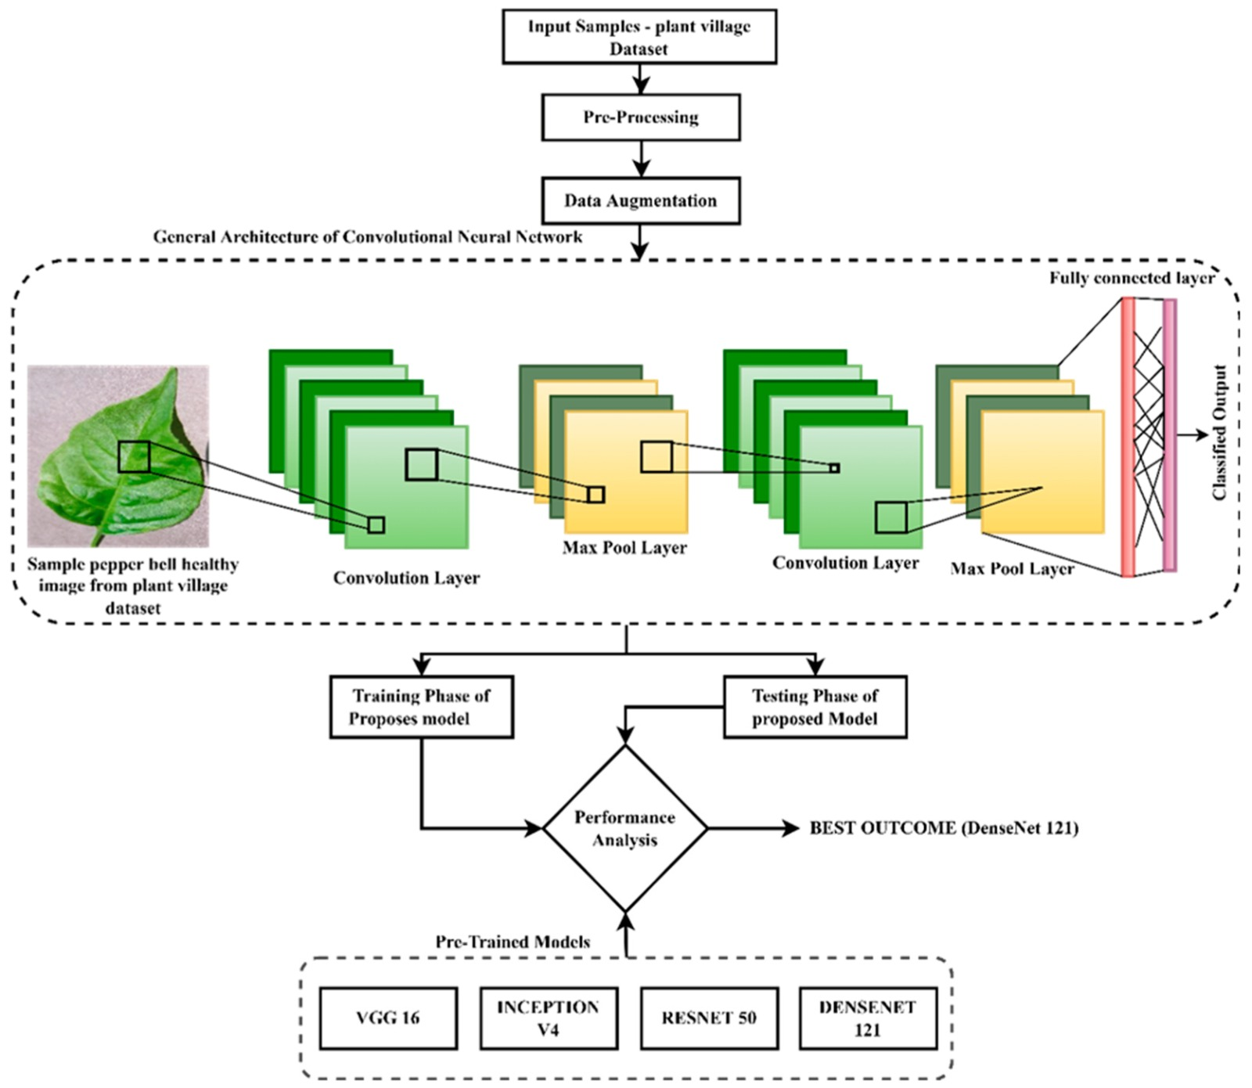
Activity

Slide 27
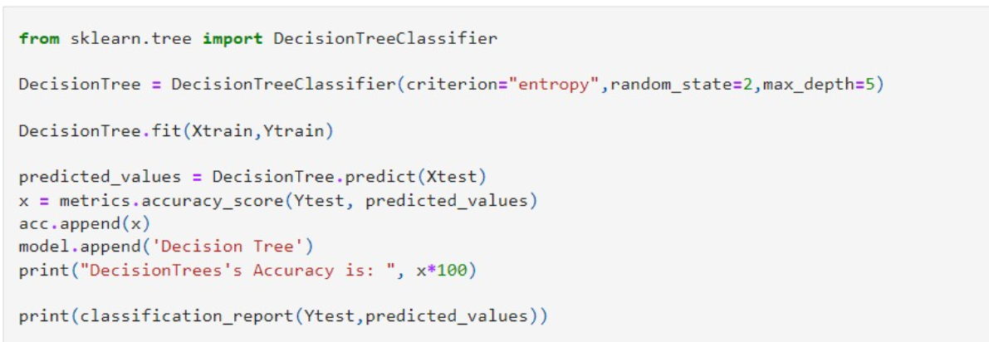
Implementation
Decision Tree

Slide 28
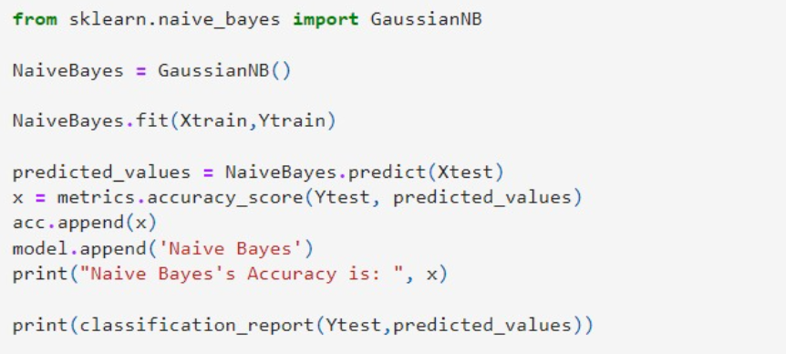
Naive Bayes

Slide 29
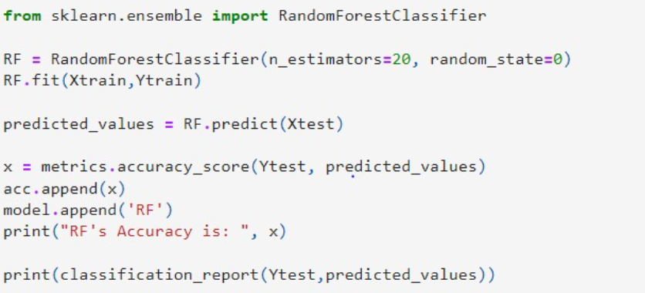
Random Forest

Slide 30
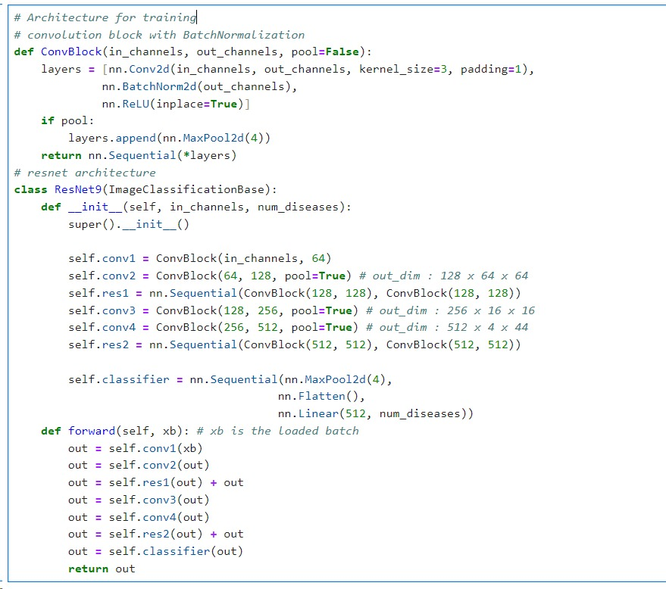
CNN(ResNet Architecture)

Slide 31
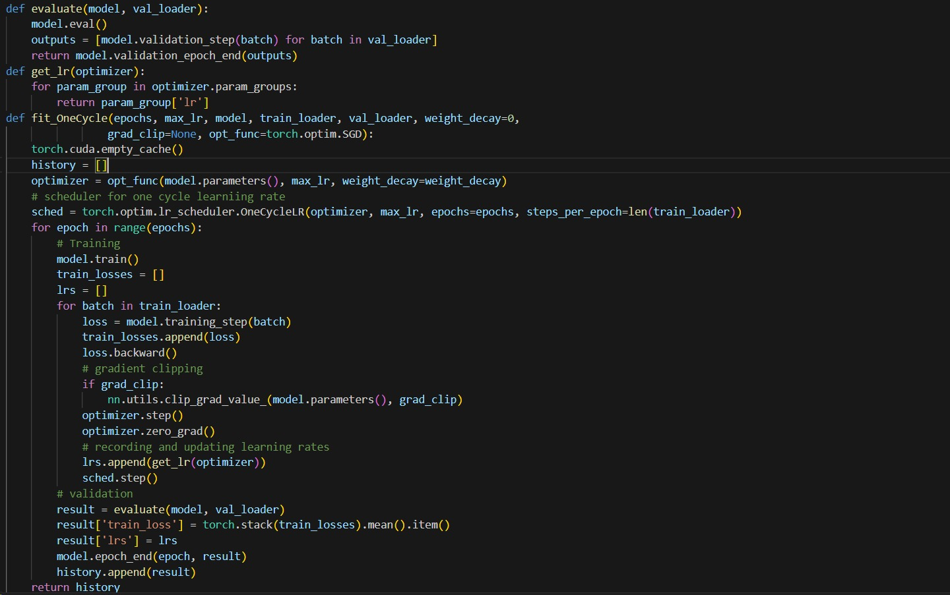

Slide 32
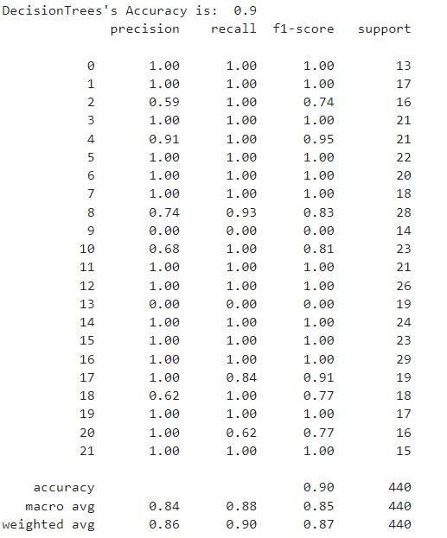
Outputs
Decision Tree

Slide 33
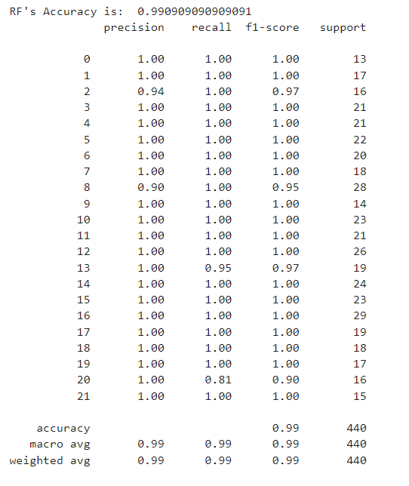
Naive Bayes

Slide 34
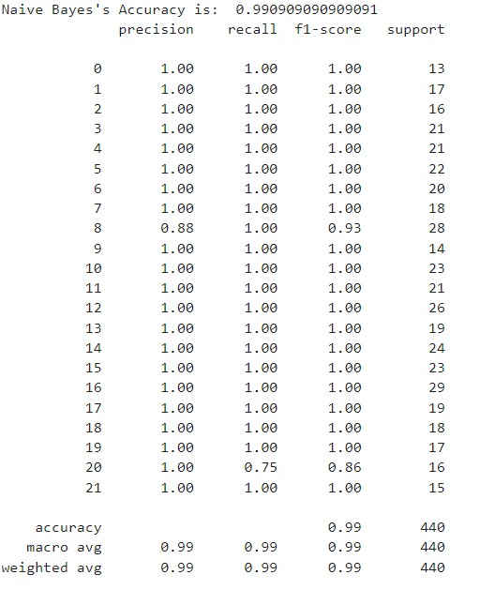
Random Forest

Slide 35
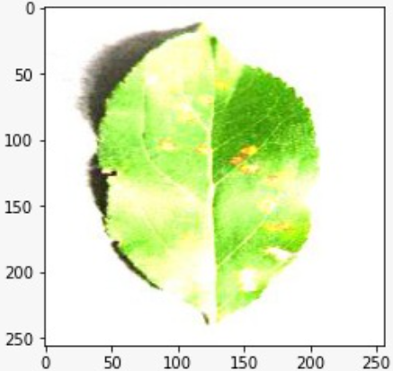
CNN(ResNet)
Label: AppleCedarRust1.JPG , Predicted: Apple___Cedar_apple_rust

Slide 36
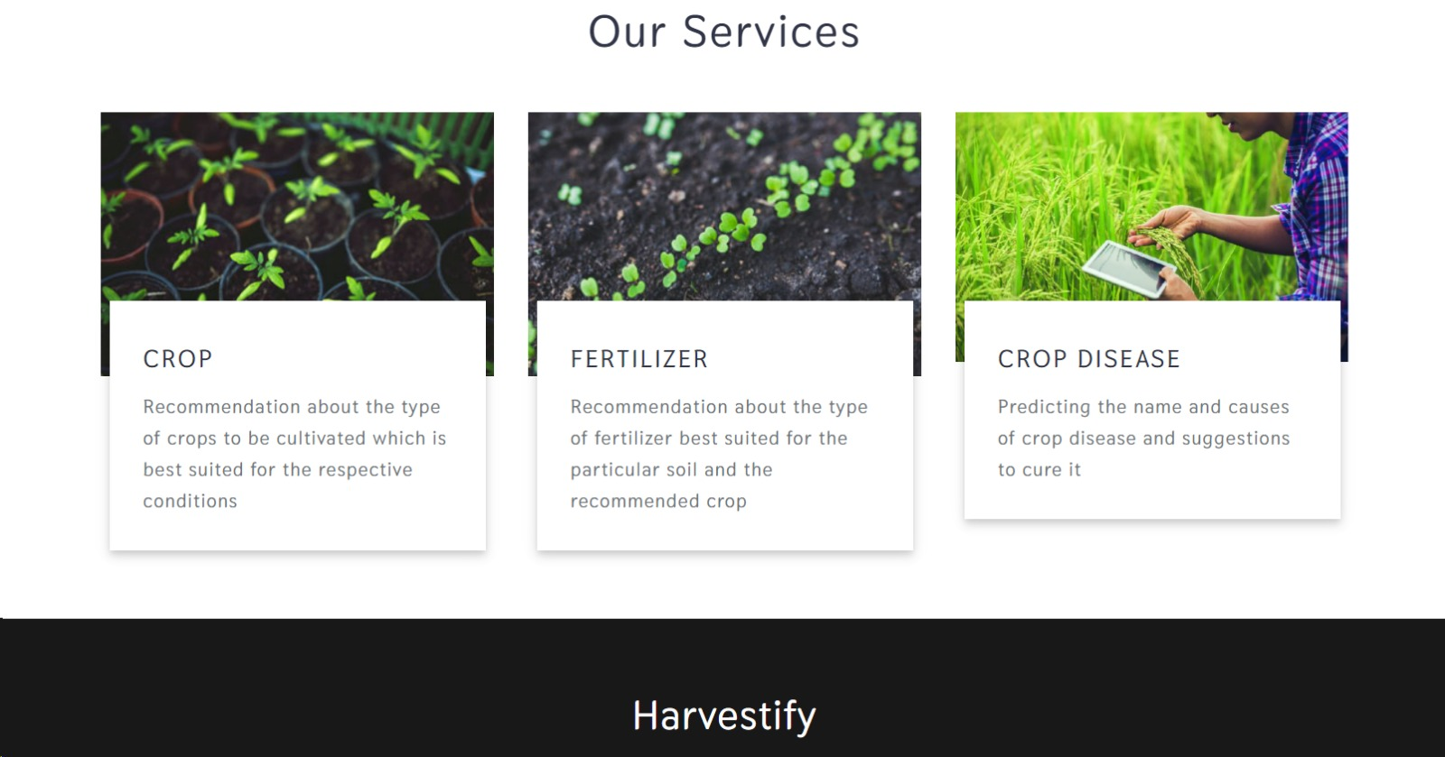
Results

Slide 37
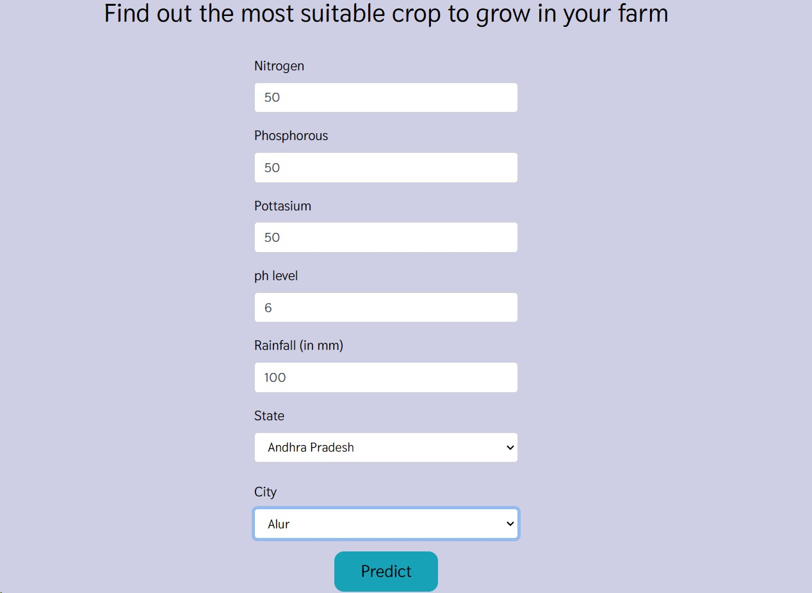
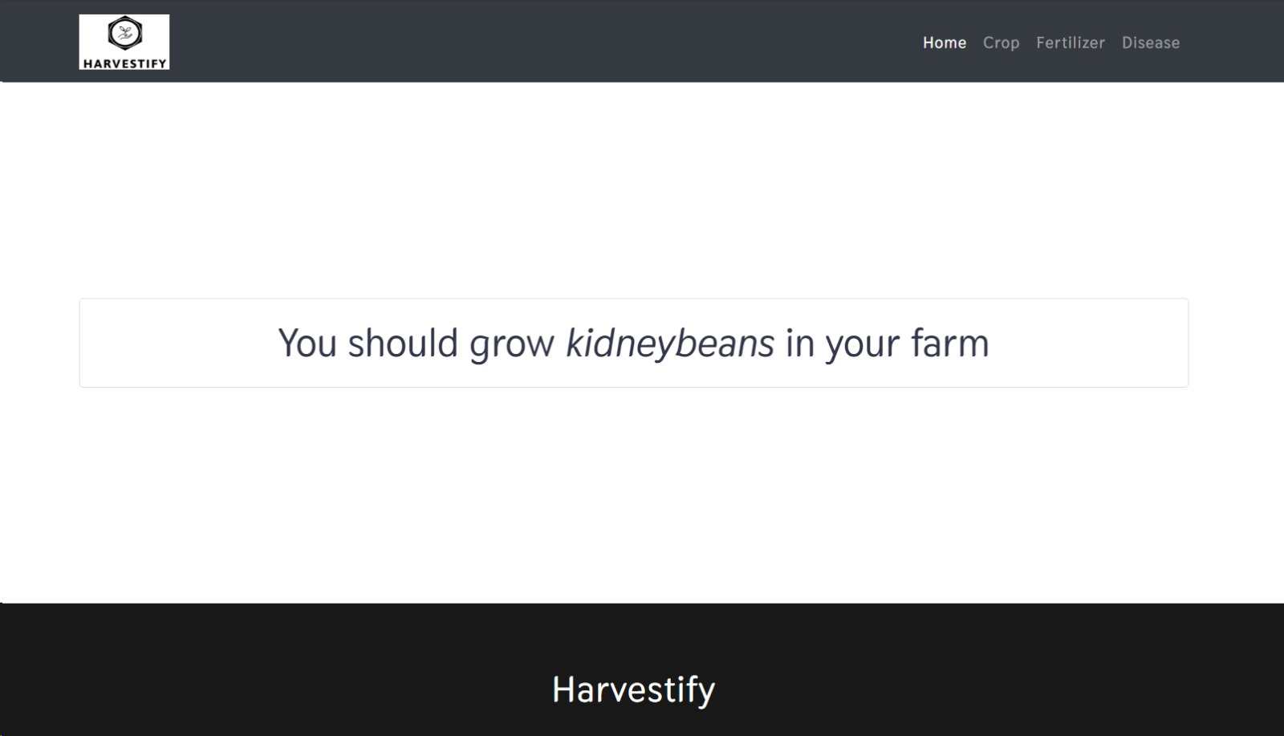
Crop Recommendation

Slide 38
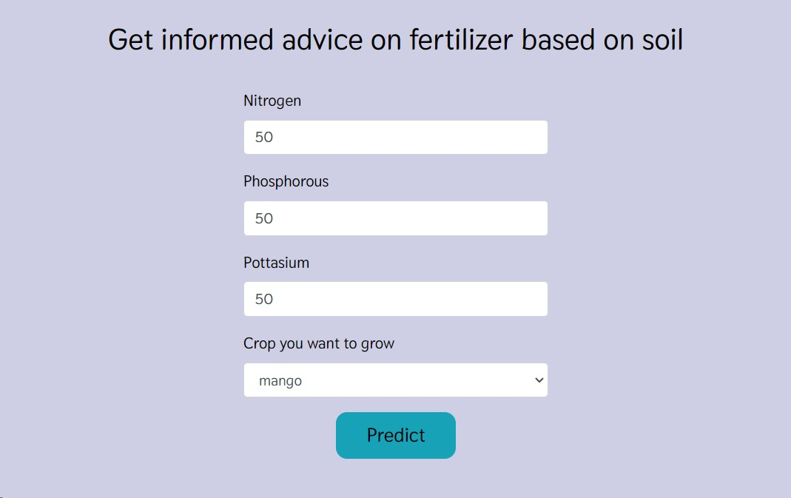
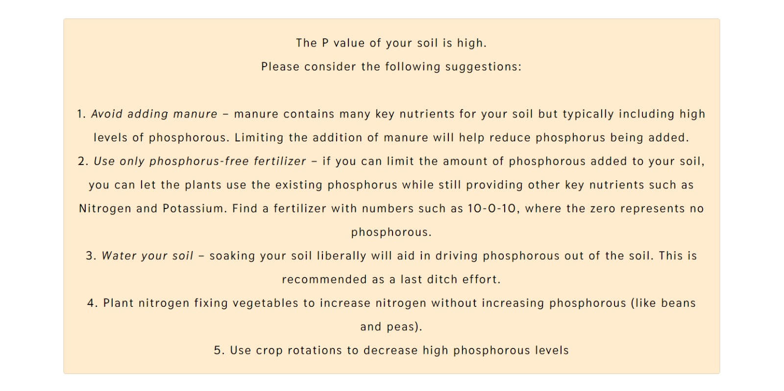
Fertilizer Suggestion

Slide 39
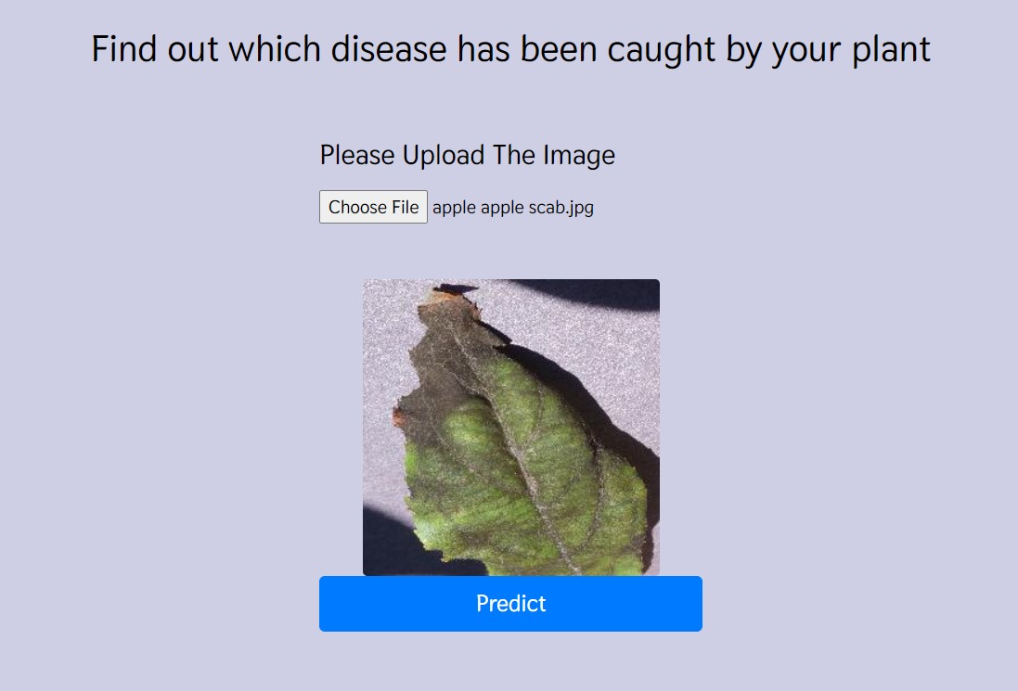
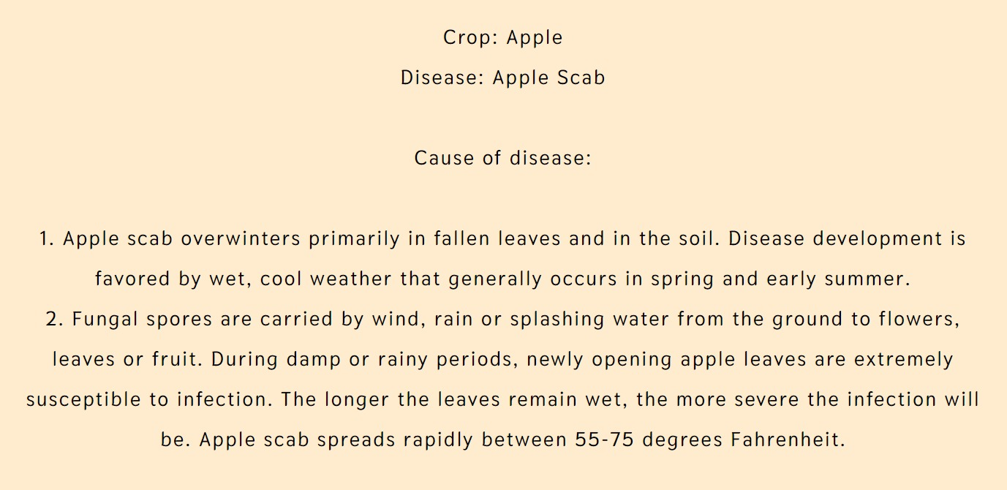
Plant Disease Detection

Slide 40
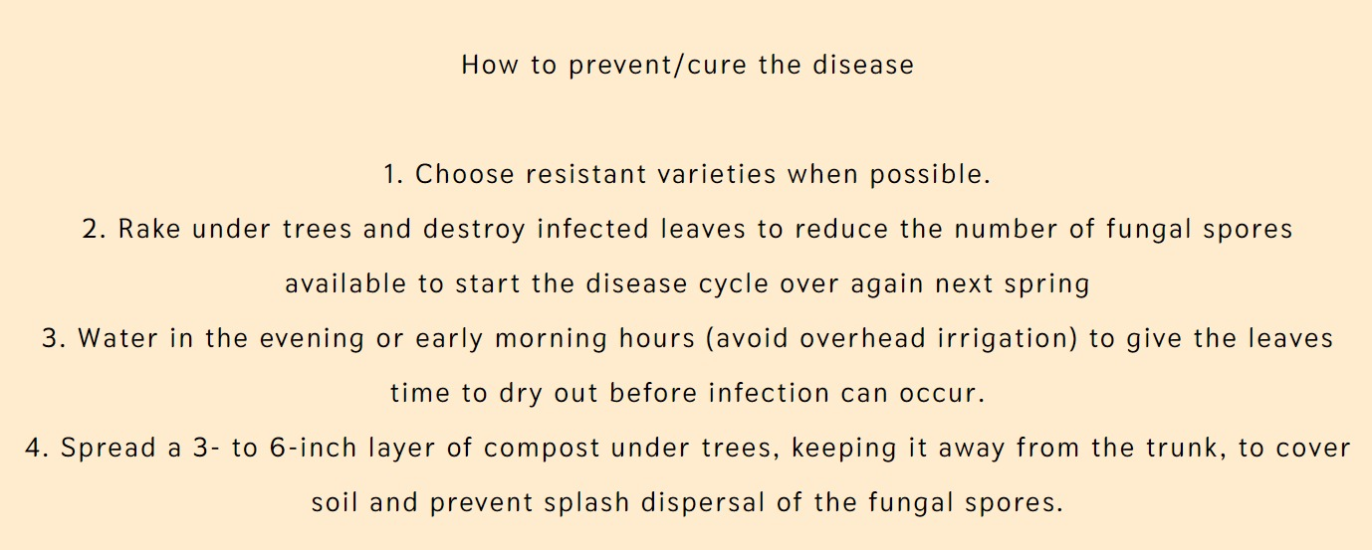
Contd..

Slide 41
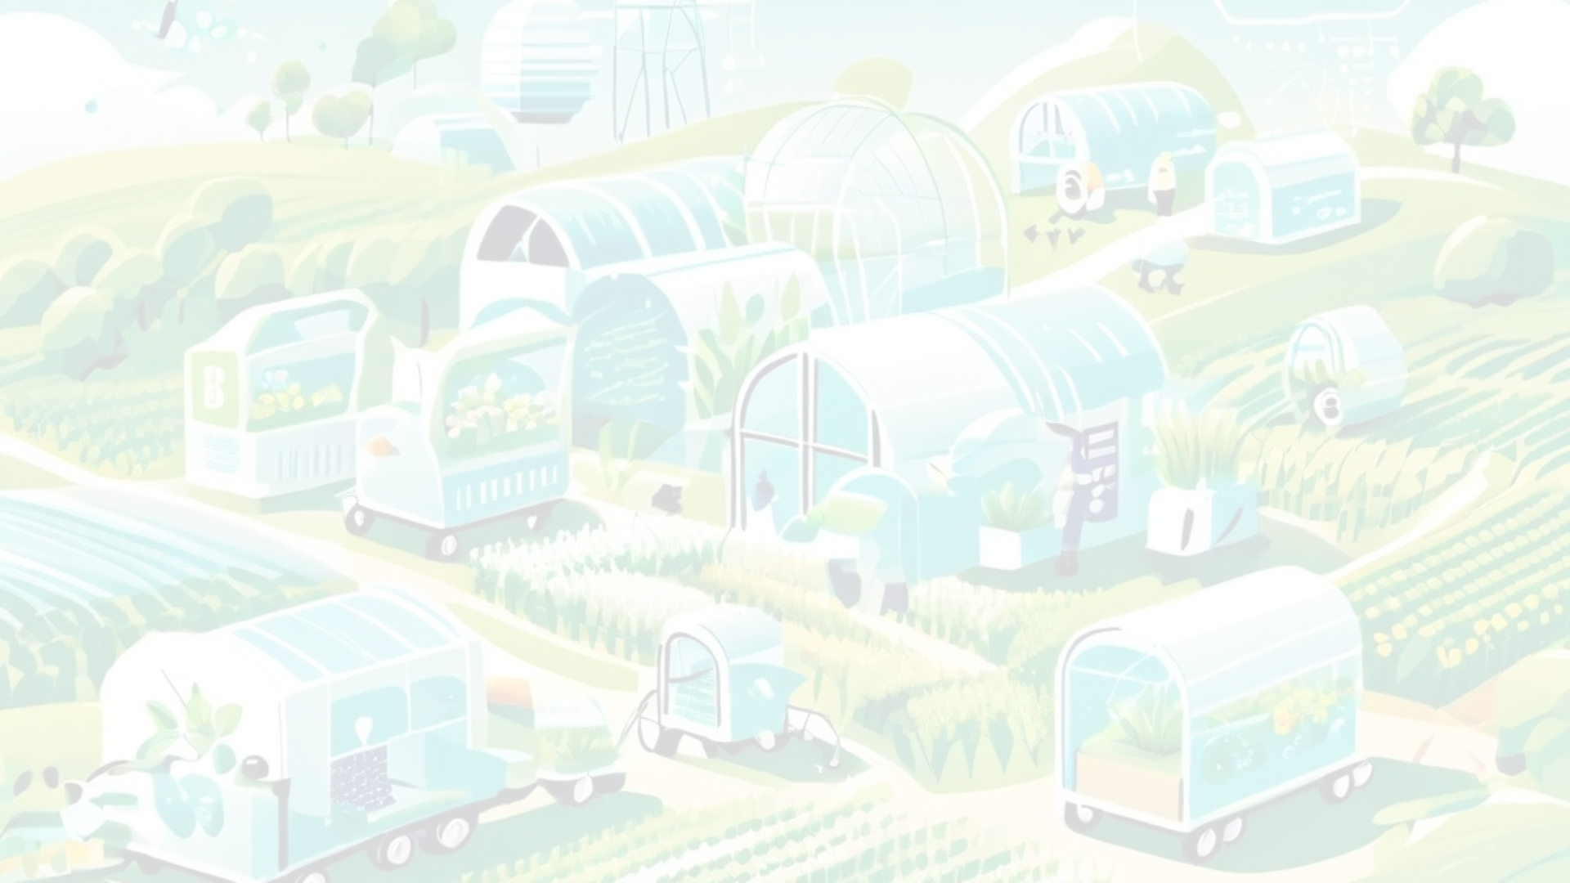
Conclusions
In this project, we utilized Naive Bayes, Decision Tree, Random Forest to classify the crop and convolutional neural network architecture, Resnet for plant disease detection. The proposed algorithm is implemented successfully to train the system. The accuracy percentage on the test set is 99.8% with no overfitting. also this work can expanded into further to develop an app through which one would also know the remedy to a plant disease.
Algorithm | Accuracy
Decision Tree | 99%
Random Forest | 99%
Naive Bayes | 99%
CNN(ResNet) | 98.3%

